Slide 1
Chapter 6
Pipelining

Slide 2
Chapter Outline
Pipelining: overlapped instruction execution
Hazards that limit pipelined performance gain
Hardware/software implications of pipelining
Influence of pipelining on instruction sets
Pipelining in superscalar processors

Slide 3
Basic Concept of Pipelining
Circuit technology and hardware arrangement influence the speed of execution for programs
All computer units benefit from faster circuits
Pipelining involves arranging the hardware to perform multiple operations simultaneously
Similar to assembly line where product moves through stations that perform specific tasks
Same total time for each item, but overlapped

Slide 4
Pipelining in a Computer
Focus on pipelining of instruction execution
Multistage datapath in Chapter 5 consists of: Fetch, Decode, Compute, Memory, Write
Instructions fetched & executed one at a time with only one stage active in any cycle
With pipelining, multiple stages are active simultaneously for different instructions
Still 5 cycles to execute, but rate is 1 per cycle

Slide 5
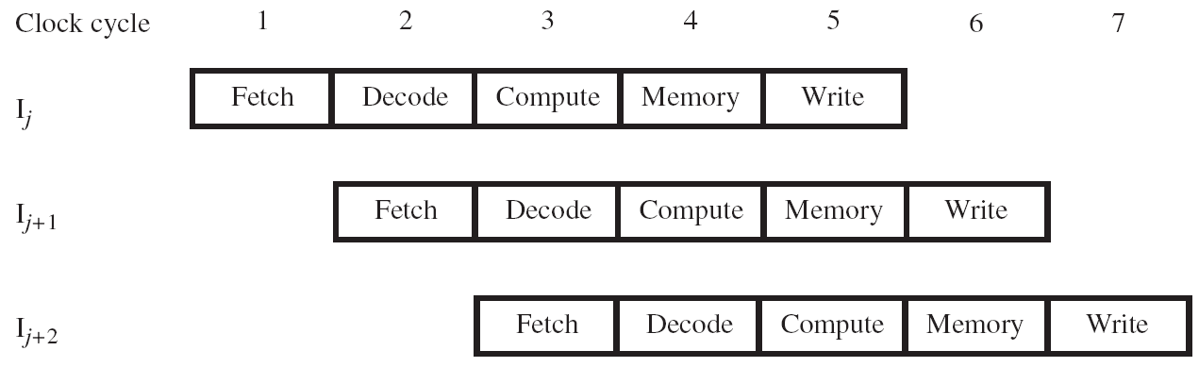

Slide 6
Pipeline Organization
Use program counter (PC) to fetch instructions
A new instruction enters pipeline every cycle
Carry along instruction-specific information as instructions flow through the different stages
Use interstage buffers to hold this information
These buffers incorporate RA, RB, RM, RY, RZ, IR, and PC-Temp registers from Chapter 5
The buffers also hold control signal settings

Slide 7
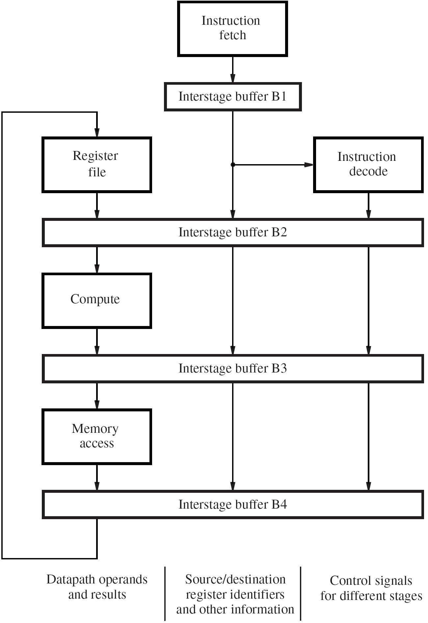

Slide 8
Pipelining Issues
Consider two successive instructions I_{j} and I_{j+1}
Assume that the destination register of I_{j} matches one of the source registers of I_{j+1}
Result of I_{j} is written to destination in cycle 5
But I_{j+1} reads old value of register in cycle 3
Due to pipelining, I_{j+1} computation is incorrect
So stall (delay) I_{j+1} until I_{j} writes the new value
Condition requiring this stall is a data hazard

Slide 9
Data Dependencies
Now consider the specific instructions
Add R2, R3, #100
Subtract R9, R2, #30
Destination R2 of Add is a source for Subtract
There is a data dependency between them because R2 carries data from Add to Subtract
On non-pipelined datapath, result is available
in R2 because Add completes before Subtract

Slide 10
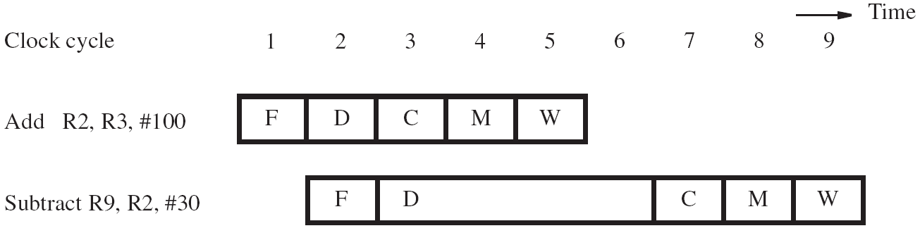
Stalling the Pipeline
With pipelined execution, old value is still in register R2 when Subtract is in Decode stage
So stall Subtract for 3 cycles in Decode stage
New value of R2 is then available in cycle 6

Slide 11
Details for Stalling the Pipeline
Control circuitry must recognize dependency while Subtract is being decoded in cycle 3
Interstage buffers carry register identifiers for source(s) and destination of instructions
In cycle 3, compare destination identifier in Compute stage against source(s) in Decode
R2 matches, so Subtract kept in Decode
while Add allowed to continue normally

Slide 12
Details for Stalling the Pipeline
Stall the Subtract instruction for 3 cycles by holding interstage buffer B1 contents steady
But what happens after Add leaves Compute?
Control signals are set in cycles 3 to 5 to create an implicit NOP (No-operation) in Compute
NOP control signals in interstage buffer B2 create a cycle of idle time in each later stage
The idle time from each NOP is called a bubble

Slide 13
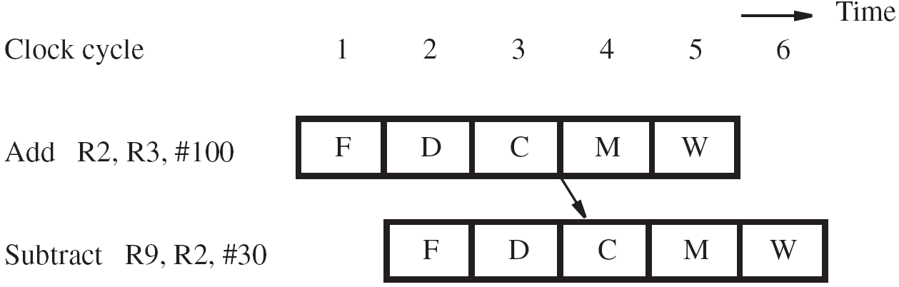
Operand Forwarding
Operand forwarding handles dependencies without the penalty of stalling the pipeline
For the preceding sequence of instructions, new value for R2 is available at end of cycle 3
Forward value to where it is needed in cycle 4

Slide 14
Details for Operand Forwarding
Introduce multiplexers before ALU inputs to use contents of register RZ as forwarded value
Control circuitry now recognizes dependency in cycle 4 when Subtract is in Compute stage
Interstage buffers still carry register identifiers
Compare destination of Add in Memory stage with source(s) of Subtract in Compute stage
Set multiplexer control based on comparison

Slide 15
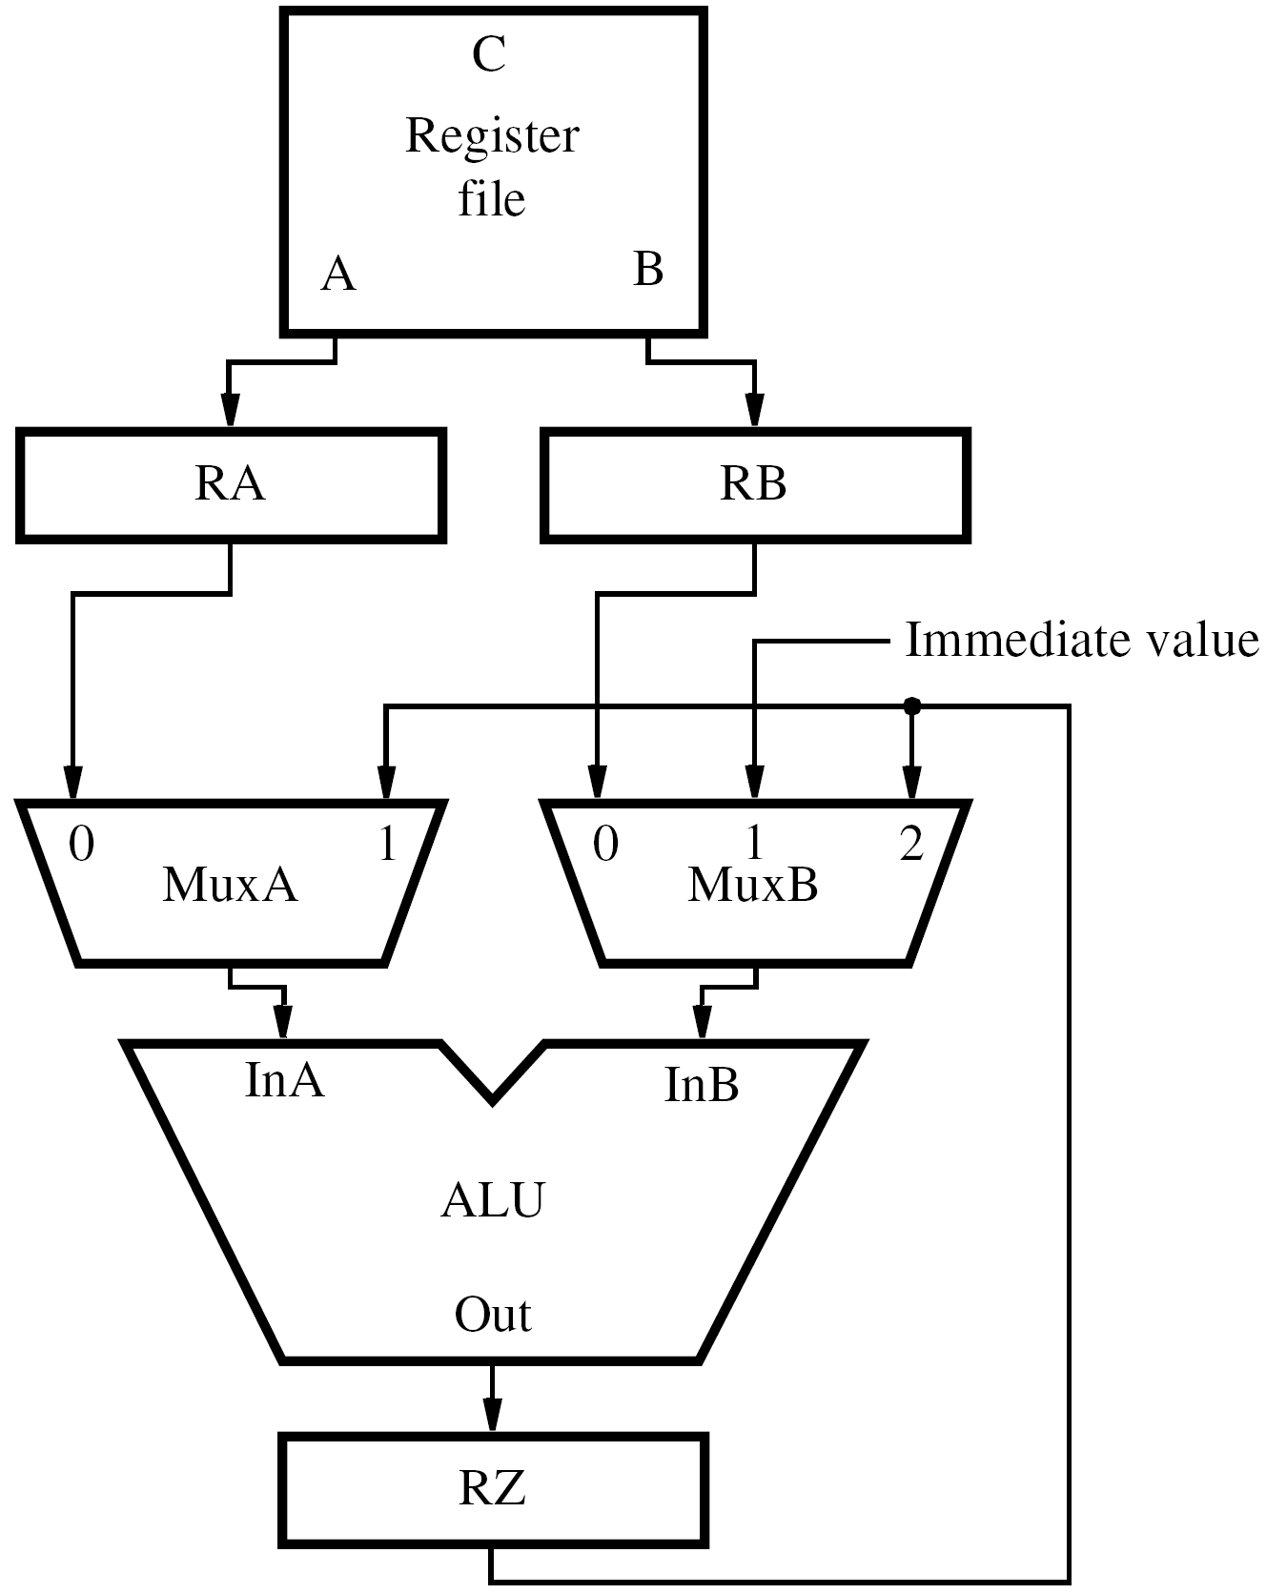

Slide 16
Software Handling of Dependencies
Compiler can generate & analyze instructions
Data dependencies are evident from registers
Compiler puts three explicit NOP instructions between instructions having a dependency
Delay ensures new value available in register but causes total execution time to increase
Compiler can optimize by moving instructions into NOP slots (if data dependencies permit)

Slide 17
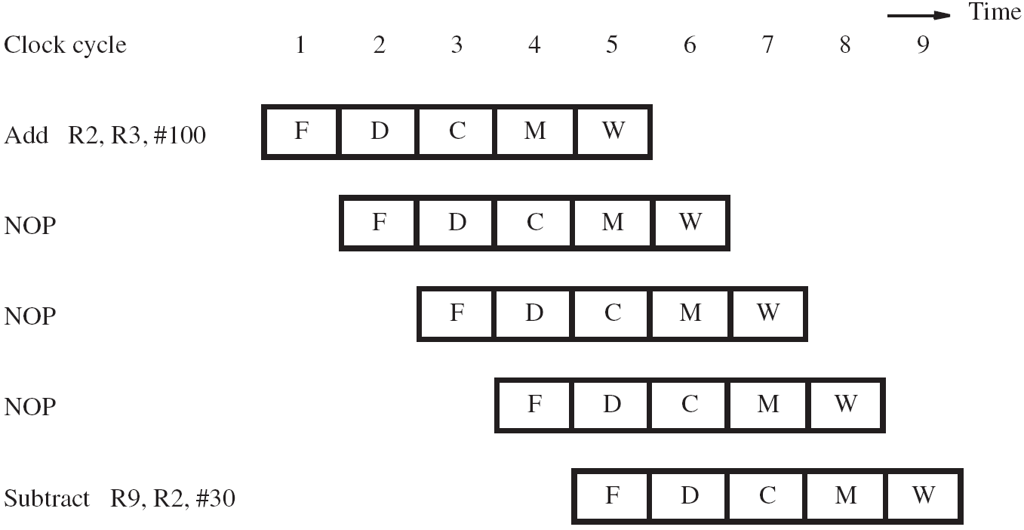

Slide 18
Memory Delays
Memory delays can also cause pipeline stalls
A cache memory holds instructions and data from the main memory, but is faster to access
With a cache, typical access time is one cycle
But a cache miss requires accessing slower main memory with a much longer delay
In pipeline, memory delay for one instruction causes subsequent instructions to be delayed

Slide 19
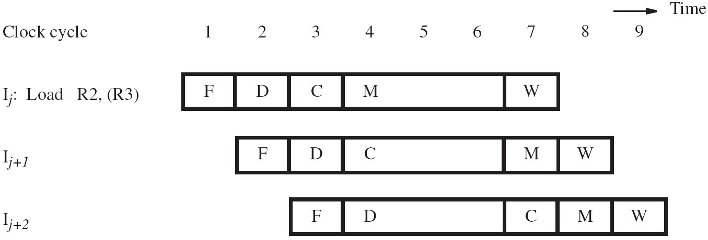

Slide 20
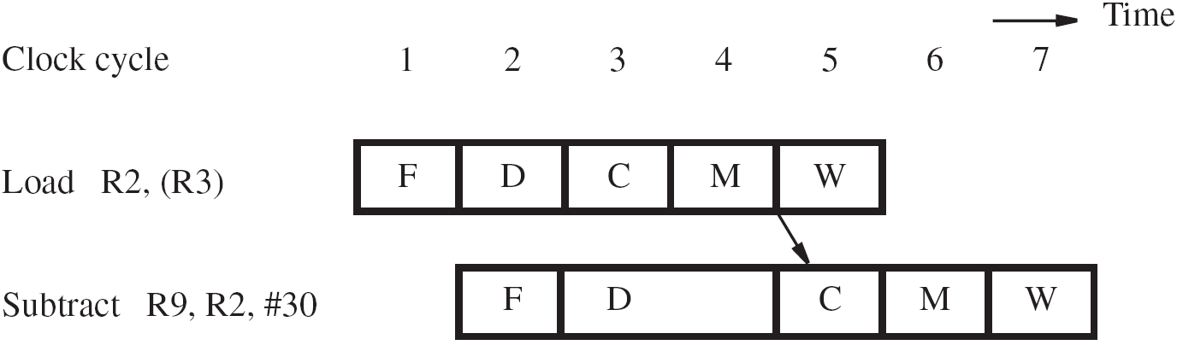
Memory Delays
Even with a cache hit, a Load instruction may cause a short delay due to a data dependency
One-cycle stall required for correct value to be forwarded to instruction needing that value
Optimize with useful instruction to fill delay

Slide 21
Branch Delays
Ideal pipelining: fetch each new instruction while previous instruction is being decoded
Branch instructions alter execution sequence, but they must be processed to know the effect
Any delay for determining branch outcome leads to an increase in total execution time
Techniques to mitigate this effect are desired
Understand branch behavior to find solutions

Slide 22
Unconditional Branches
Consider instructions I_{j} , I_{j+1} , I_{j+2} in sequence
I_{j} is an unconditional branch with target I_{k}
In Chapter 5, the Compute stage determined the target address using offset and PC+4 value
In pipeline, target I_{k} is known for I_{j} in cycle 4, but instructions I_{j+1} , I_{j+2} fetched in cycles 2 & 3
Target I_{k} should have followed I_{j} immediately, so discard I_{j+1} , I_{j+2} and incur two-cycle penalty

Slide 23
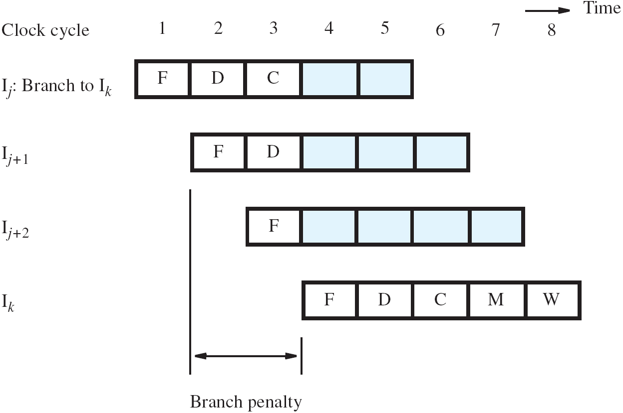

Slide 24
Reducing the Branch Penalty
In pipeline, adder for PC is used every cycle, so it cannot calculate the branch target address
So introduce a second adder just for branches
Place this second adder in the Decode stage to enable earlier determination of target address
For previous example, now only I_{j+1} is fetched
Only one instruction needs to be discarded
The branch penalty is reduced to one cycle

Slide 25
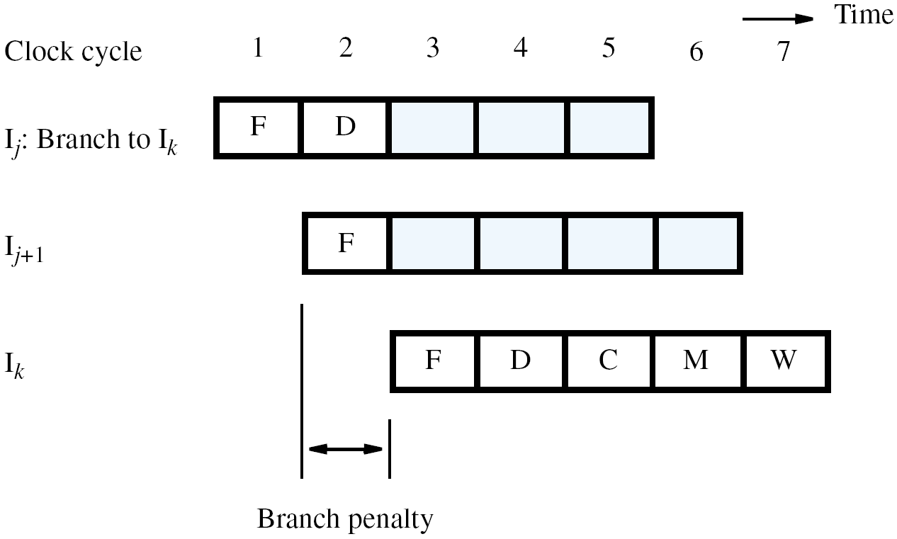

Slide 26
Conditional Branches
Consider a conditional branch instruction:
Branch_if_[R5]=[R6] LOOP
Requires not only target address calculation, but also requires comparison for condition
In Chapter 5, ALU performed the comparison
Target address now calculated in Decode stage
To maintain one-cycle penalty, we introduce a comparator just for branches in Decode stage

Slide 27
The Branch Delay Slot
Let both branch decision and target address be determined in Decode stage of pipeline
Instruction immediately following a branch is always fetched, regardless of branch decision
That next instruction is discarded with penalty, except when conditional branch is not taken
The location immediately following the branch is called the branch delay slot

Slide 28
The Branch Delay Slot
Instead of conditionally discarding instruction in delay slot, always let it complete execution
Let compiler find an instruction before branch to move into slot, if data dependencies permit
Called delayed branching due to reordering
If useful instruction put in slot, penalty is zero
If not possible, insert explicit NOP in delay slot for one-cycle penalty, whether or not taken

Slide 29
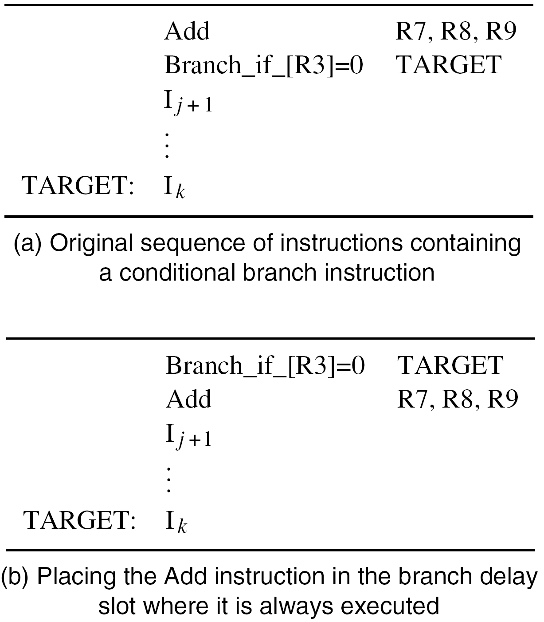

Slide 30
Branch Prediction
A branch is decided in Decode stage (cycle 2) while following instruction is always fetched
Following instruction may require discarding (or with delayed branching, it may be a NOP)
Instead of discarding the following instruction, can we anticipate the actual next instruction?
Two aims: (a) predict the branch decision
(b) use prediction earlier in cycle 1

Slide 31
Static Branch Prediction
Simplest approach: assume branch not taken
Penalty if prediction disproved during Decode
If branches are random, accuracy is 50%
But a branch at end of a loop is usually taken
So for backward branch, always predict taken
Use target address as soon as it is available
Expect higher accuracy for this special case, but what about accuracy for other branches?

Slide 32
Dynamic Branch Prediction
Idea: track branch decisions during execution for dynamic prediction to improve accuracy
Simplest approach: use most recent outcome for likely taken (LT) or likely not-taken (LNT)
For branch at end of loop, we mispredict in last pass, and in first pass if loop is re-entered
Avoid misprediction for loop re-entry with four states (ST, LT, LNT, SNT) for strongly/likely
Must be wrong twice to change prediction

Slide 33
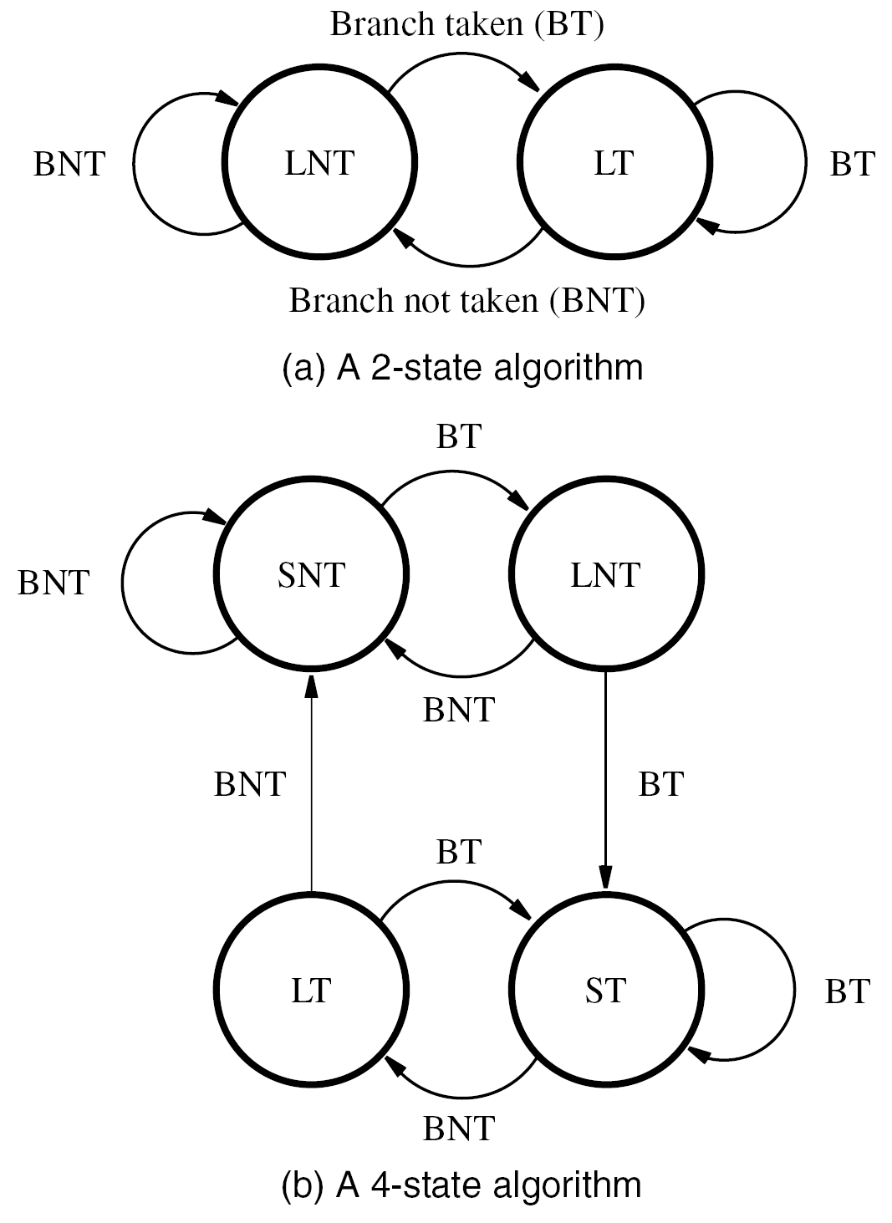

Slide 34
Branch Target Buffer
Prediction only provides a presumed decision
Decode stage computes target in cycle 2
But we need target (and prediction) in cycle 1
Branch target buffer stores target address and history from last execution of each branch
In cycle 1, use branch instruction address to look up target and use history for prediction
Fetch in cycle 2 using prediction; if mispredict detected during Decode, correct it in cycle 3

Slide 35
Superscalar Operation
Introduce multiple execution units to enable multiple instruction issue for > 1 instr./cycle
This organization is for a superscalar processor
An elaborate fetch unit brings 2+ instructions into an instruction queue in every cycle
A dispatch unit takes 2+ instructions from the head of queue in every cycle, decodes them, sends them to appropriate execution units
A completion unit writes results to registers

Slide 36
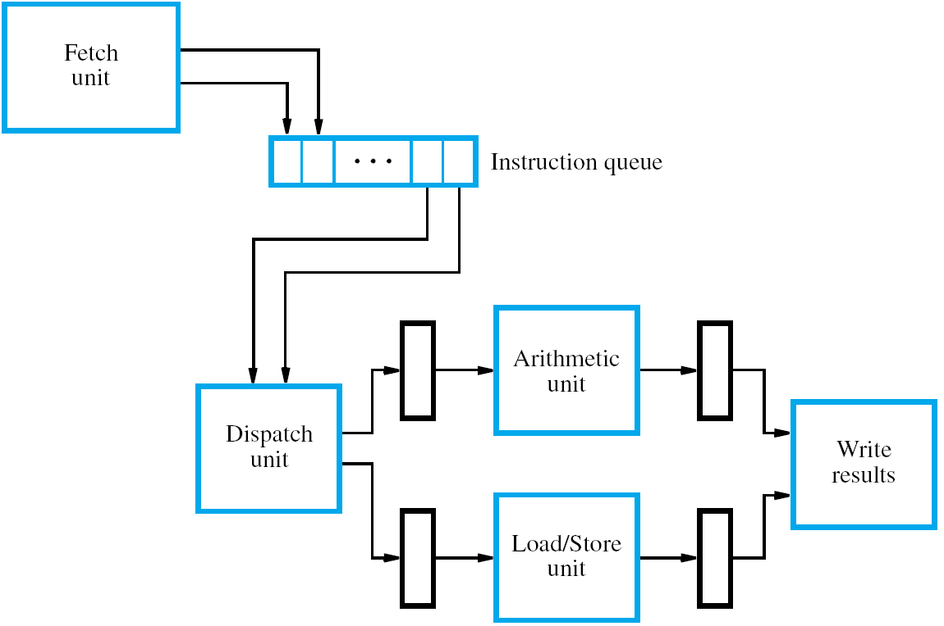

Slide 37
Superscalar Operation
Minimum superscalar arrangement consists of a Load/Store unit and an arithmetic unit
Because of Index mode address calculation, Load/Store unit has a two-stage pipeline
Arithmetic unit usually has one stage
For two execution units, how many operands?
Up to 4 inputs, so register file has 4 read ports
Up to 2 results, so also need 2 write ports
(and methods to prevent write to same reg.)

Slide 38
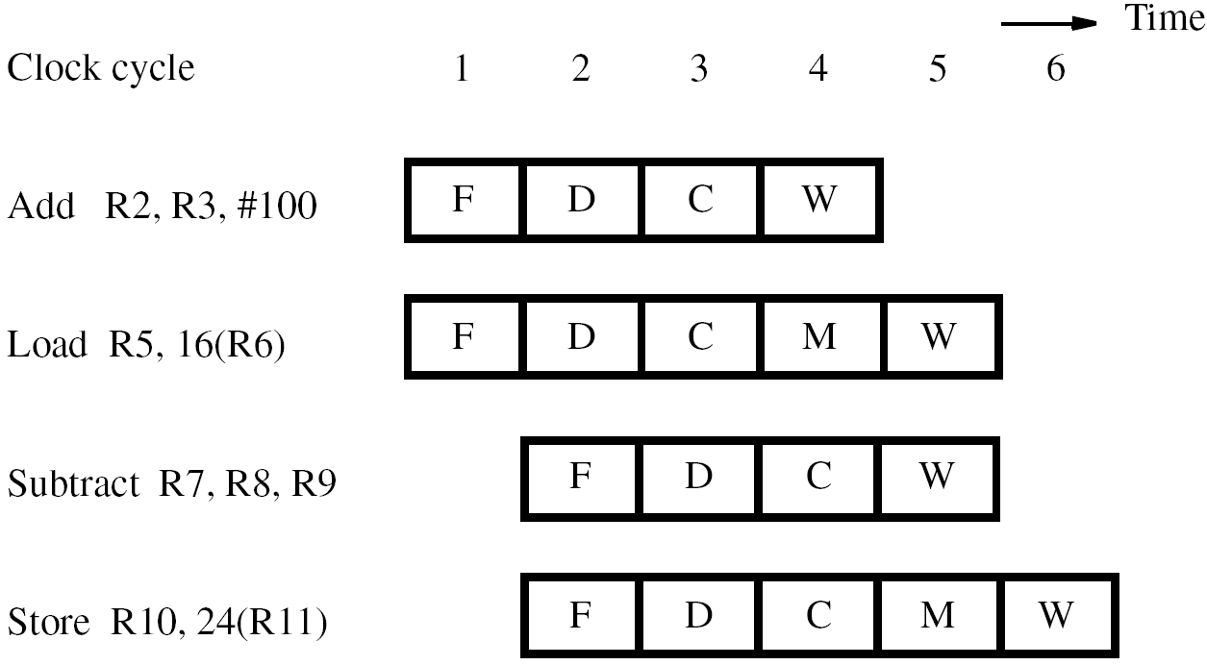

Slide 39
Branches and Data Dependencies
With no branches or data dependencies, interleave arithmetic & memory instructions to obtain maximum throughput (2 per cycle)
But branches do occur and must be handled
Branches processed entirely by fetch unit to determine which instructions enter queue
Fetch unit uses prediction for all branches
Necessary because decisions may need values produced by other instructions in progress

Slide 40
Branches and Data Dependencies
Speculative execution: results of instructions not committed until prediction is confirmed
Requires extra hardware to track speculation and to recover in the event of misprediction
For data dependencies between instructions, the execution units have reservation stations
They buffer register identifiers and operands for dispatched instructions awaiting execution
Broadcast results for stations to capture & use

Slide 41
Out-of-Order Execution
With instructions buffered at execution units, should execution reflect original sequencing?
If two instructions have no dependencies, there are no actual ordering constraints
This enables out-of-order execution, but then leads to imprecise exceptions in program state
For precise exceptions, must commit results strictly in original order with extra hardware

Slide 42
Execution Completion
To commit results in original program order, superscalar processors can use 2 techniques
Register renaming uses temporary registers to hold new data before it is safe for final update
Reorder buffer in commitment unit is where dispatched instructions placed in strict order
Update the actual destination register only for instruction at head of queue in reorder buffer
Ensures instructions retired in original order

Slide 43
Dispatch Operation
Dispatch of instruction proceeds only when all needed resources available (temp. register, space in reservation station & reorder buffer)
If instruction has some but not all resources, should a subsequent instruction proceed?
Decisions must avoid deadlock conditions
(two instructions need each other’s resources)
More complex, so easier to use original order, particularly with more than 2 execution units

Slide 44
Pipelining in CISC Processors
Load/Store architecture simplifies pipelining; influenced development of RISC processors
CISC processors introduce complications from instructions with multiple memory operands and side effects (autoincrement, cond. codes)
But existing CISC architectures later pipelined (with more effort) after development of RISC
Examples: Freescale ColdFire and Intel IA-32

Slide 45
Concluding Remarks
Pipelining overlaps activity for 1 instr./cycle
Combine it with multiple instruction issue
in superscalar processors for >1 instr./cycle
Potential performance gains depend on:
  instruction set characteristics
  design of pipeline hardware
  ability of compiler to optimize code
Interaction of these aspects is a key factor

